Slide 1
STATE OF TEXAS v LEXI ISAACKS

Slide 2
WHY IS IT SO IMPORTANT TO NOT DRIVE WHILE INTOXICATED?

Slide 3
DWI v. INTOX MANSLAUGHTER

Slide 4
WHY IS IT SO IMPORTANT TO WEAR YOUR SEATBELT?

Slide 5
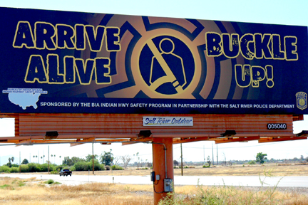

Slide 6
ACCIDENTS NOT DELIBERATES

Slide 7
RIGHT TO AN ATTORNEY
6th Amendment
What kind of attorney would you want?
Adversarial system – objections, hard questions, etc.
Notes:
What kind of attorney? Aggressive? That’s describes me.
Is it OK for me to fight as hard as I can for Raymond?

Slide 8
HAVE YOU EVER RUN A…

Slide 9
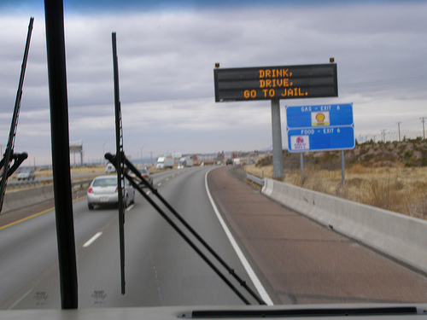
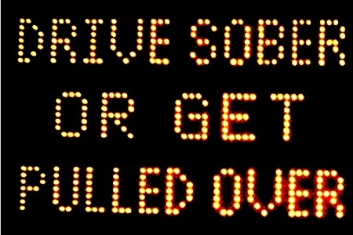
DRINKING
Drink, Drive, Go to Jail
Drive Sober or Get Pulled Over
Going Out Tonight, So Are We

Slide 11
NOT ILLEGAL TO DRINK AND THEN DRIVE; as long as you’re NOT intoxicated

Slide 12
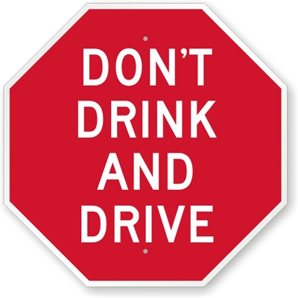
BUT WHO STILL SAYS…

Slide 13
DRINKING PATTERNS
A. REGULARLY
B. OCCASIONALLY
C. RARELY
D. NEVER
E. NOT ANY MORE

Slide 14
ALCOHOL
MEMBER OF MADD
MEMBER OF AA
STRONGLY AGREE WITH “NO REFUSAL” WEEKENDS
ALCOHOLISM IN FAMILY
NO ALCOHOL IN HOME
INJURED/VICTIM OF ALCOHOL RELATED CRIME

Slide 15
TRUE OR FALSE?
I BELIEVE THE DRINKING AND DRIVING LAWS ARE NOT SEVERE ENOUGH IN OUR STATE?

Slide 16
TRUE OR FALSE?
IF SOMEONE HAS BEEN DRINKING AND THEN IS INVOLVED IN AN ACCIDENT WHERE SOMEONE DIES, THEY ARE PROBABLY GUILTY OF INTOXICATED MANSLAUGHTER?

Slide 17
TRUE OR FALSE?
IF SOMEONE ISGUILTY OF INTOXICATED MANSLAUGHTER, THEY SHOULD PROBABLY GO TO PRISON?

Slide 18
RELATED TO?

Slide 19
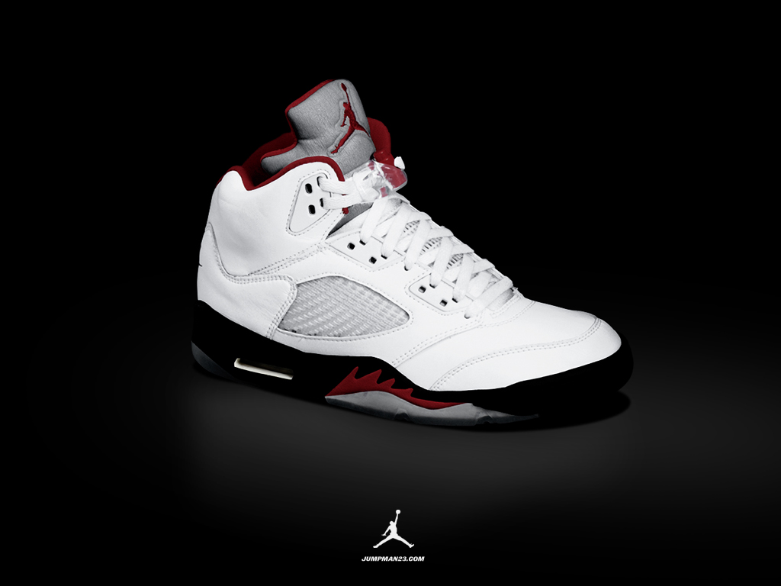
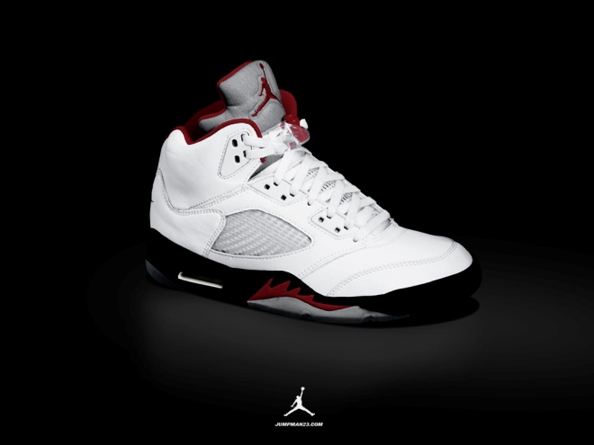
NORMAL v AVERAGE
SIZE 6 SIZE 10

Slide 21
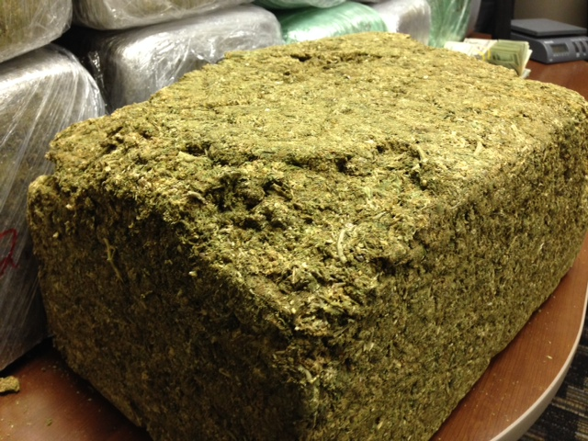

Slide 22
AT THE TIME OF DRIVING
Retrograde Extrapolation
Factors that Can Affect This?

Slide 23
FACTORS THAT CAN AFFECT?
Person:
Eating:
Drinking:
Body:

Slide 24
HOW DO YOU FEEL ABOUT POLICE LABS?
NEVER TRUST ALWAYS TRUST

Slide 25
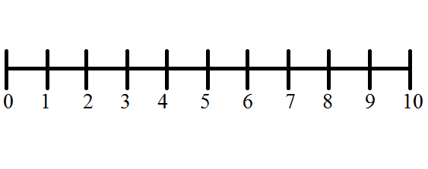
PRESUMPTION OF INNOCENCE
INNOCENT GUILTY

Slide 26
ASSUME
v.
PRESUME

Slide 27
PRESUMPTION OF INNOCENCE

Slide 29
THE LAW
“NOT GUILTY” if
Operation not proven Beyond a Reasonable Doubt
“NOT GUILTY” if
Intoxication not proven Beyond a Reasonable Doubt
“NOT GUILTY” if
Alcohol not proven to have caused the death by accident or mistake beyond a reasonable doubt
“NOT GUILTY” if
ANY of the elements alleged not proven Beyond a Reasonable Doubt
Notes:
Do you understand that is the law ?
Can you commit to me that ...?
Everyone seen the signs “if you drink, don’t drive”
Recognize that is NOT the law ?
Does anyone believe that the law should be that way ?

Slide 30
ANOTHER CAUSE OF DEATH (Concurrent Causation)
A person is criminally responsible if the result would not have occurred but for his conduct, operating either alone or concurrently with another cause, unless the concurrent cause was clearly sufficient to produce the result and the conduct of the actor clearly insufficient.

Slide 31
ANOTHER CAUSE OF DEATH (Concurrent Causation)
A person is criminally responsible if the result would not have occurred but for his conduct, operating either alone or concurrently with another cause, unless the concurrent cause was clearly sufficient to produce the result and the conduct of the actor clearly insufficient.

Slide 32
ANOTHER CAUSE OF DEATH (Concurrent Causation)
A person is criminally responsible if the result would not have occurred but for his conduct, operating either alone or concurrently with another cause, unless the concurrent cause was clearly sufficient to produce the result and the conduct of the actor clearly insufficient.

Slide 34
PURPOSE OF PICTURES OF DEATH
Who would be bothered by seeing pictures of death?
STIPULATE TO DEATH
Now, what is the purpose of the pictures of death?

Slide 35
“GOLDEN RULE QUESTION”
Is there ANY reason you do not believe you can be a fair and impartial juror in THIS case ?
Would you want 12 people who felt and thought the same way you do acting as jurors in a case where a friend or relative was charged with this offense ?
Notes:
Cover DC Objections

Slide 36
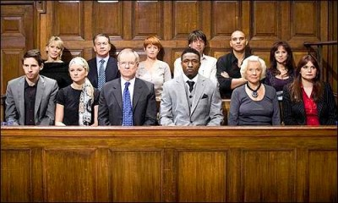
JURY SERVICE

Slide 38
PUNISHMENT
INTOXICATED MANSLAUGHTER (2nd Degree)
2-20 Years Prison
and/or
2-10 Years Probation

Slide 39
Is this the right case for me?
Could you honestly ever consider, on an Intoxication Manslaughter case, as little as two years in prison or give probation as an appropriate punishment?

Slide 40
How strongly do you agree or disagree with the following statement:
I could sentence someone to probation, if appropriate, in an Intoxication Manslaughter case.
1. Agree
2. Slightly Agree
3. Slightly Disagree
4. Disagree

Slide 41
THANK YOU

